Slide 1
A Mobility Based SIR Model for Epidemic Forecasting
Omar Malik

Slide 2
Outline
Introduction
The SIR Model
The Discretized SIR Model
The Mobility Based SIR Model
  Inter-region Mobility
  Intra-region Mobility
Modelling Covid-19 in New York City
  Data
  Results

Slide 3
Introduction
Malik, O., Gong, B., Moussawi, A., Korniss, G., Szymanski, B., Modelling Epidemic Spread in Cities Using Public Transportation as a Proxy for Generalized Mobility Trends
Our paper has been submitted to Scientific Reports and is awaiting publication.

Slide 4
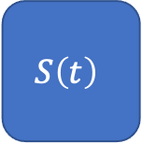

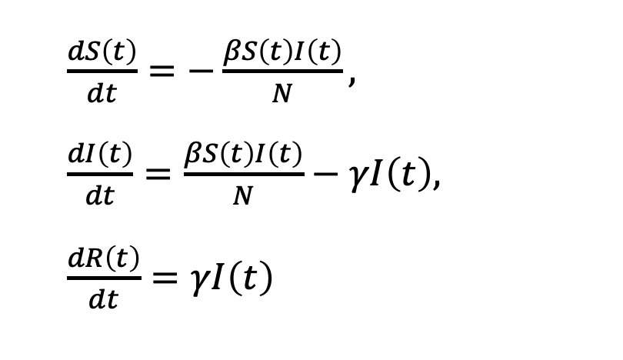

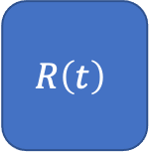
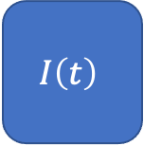
The SIR Model
$\frac{dS\left(t\right)}{dt}=−\frac{βS\left(t\right)I\left(t\right)}{N},$
$\frac{dI\left(t\right)}{dt}=\frac{βS\left(t\right)I\left(t\right)}{N}−γI\left(t\right),$
$\frac{dR\left(t\right)}{dt}=γI\left(t\right)$
Three types of individuals – Susceptible (S), Infected (I), and Recovered/Dead (R).
The total number of people, N, remains constant.
$$S\left(t\right)$$
$$β$$
$$I\left(t\right)$$
$$γ$$
$$R\left(t\right)$$

Slide 5
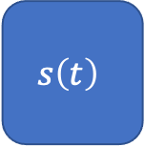
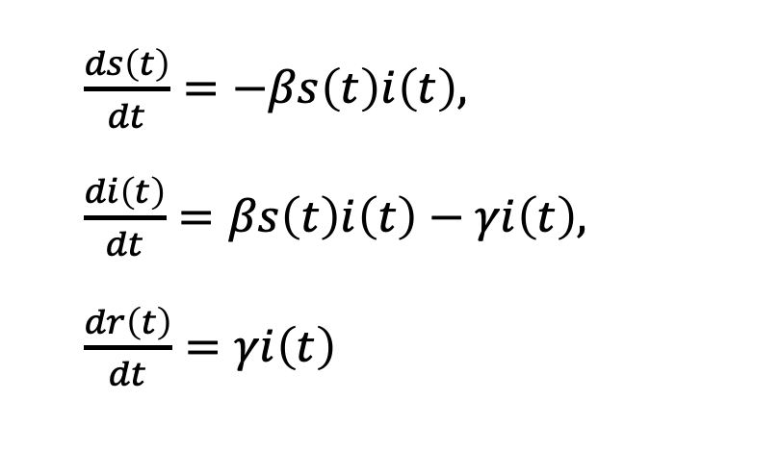
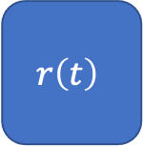
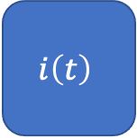
The SIR Model
$\frac{ds\left(t\right)}{dt}=−βs\left(t\right)i\left(t\right),$
$\frac{di\left(t\right)}{dt}=βs\left(t\right)i\left(t\right)−γi\left(t\right),$
$\frac{dr\left(t\right)}{dt}=γi\left(t\right)$
By dividing by N we can write the equations in terms of population densities.
$$s\left(t\right)$$
$$β$$
$$i\left(t\right)$$
$$γ$$
$$r\left(t\right)$$

Slide 6
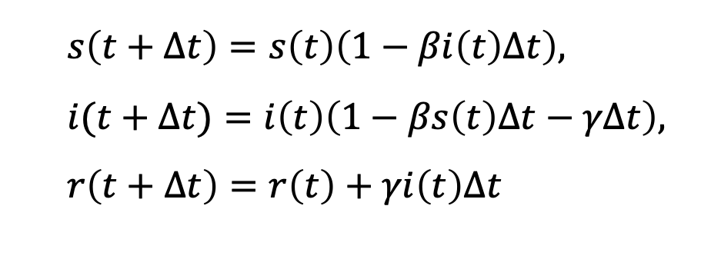
The SIR Model - Discretized
$s\left(t+Δt\right)=s\left(t\right)\left(1−βi\left(t\right)Δt\right),$
$i(t+Δt)=i\left(t\right)\left(1−βs\left(t\right)Δt−γΔt\right),$
$r\left(t+Δt\right)=r\left(t\right)+γi\left(t\right)Δt$
The differential equations can be rewritten as finite difference equations

Slide 7
The SIR Model - Limitations
Full mixing – all individuals interact with all other individuals.
Static infection rate – cannot model changes in policy and human behavior in response to epidemic.

Slide 8
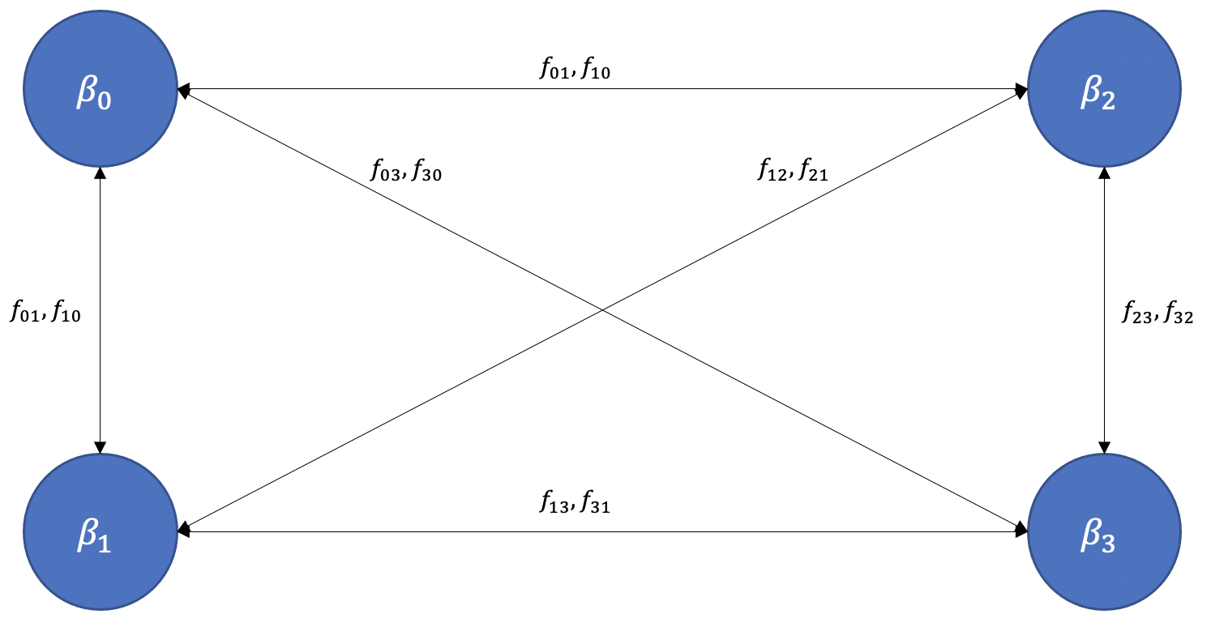
The Mobility Based SIR Model - Framework
Divide the total population into separate regions that can exchange populations.

Slide 9

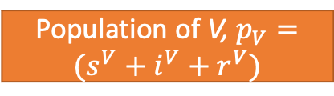


The Mobility Based SIR Model – Inter-region Mixing
Region S is visited by residents from other region, V.
Hard to model this flow with high temporal resolution.
Population of S
Population of V, $p_{V}=(s^{V}+i^{V}+r^{V})$
$$0$$
$$t_{V}$$
$$T$$

Slide 10


The Mobility Based SIR Model – Inter-region Mixing
Create an effective visiting population that interacts with S for the entire time period.
Population of S
Effective Population of V, ${p_{V^{′}}=(s}^{V}+i^{V}+r^{V}) \frac{t_{V}}{T}$
$$0$$
$$t_{V}$$
$$T$$

Slide 11
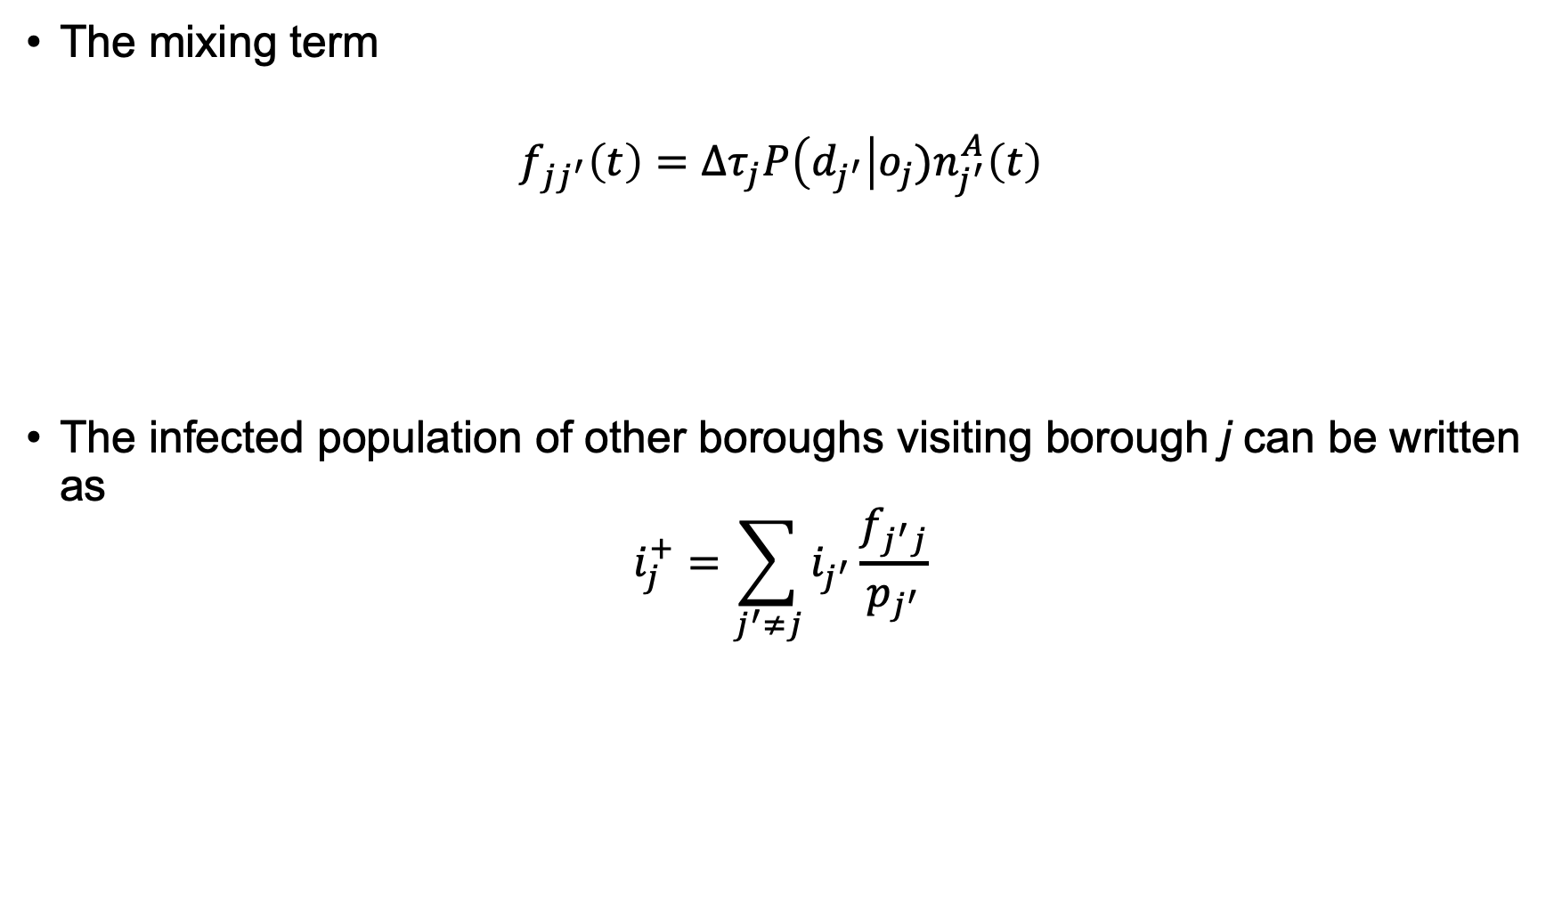
The Mobility Based SIR Model – Inter-region Mixing
Probability of a trip originating at j given that it terminates at j’
The mixing term
$$f_{jj^{′}}\left(t\right)=Δτ_{j}P\left(d_{j^{′}}\right|o_{j})n_{j^{′}}^{A}\left(t\right)$$
The infected population of other boroughs visiting borough j can be written as
$$i_{j}^{+}=\sum_{j^{′}≠j}{i_{j^{′}}\frac{f_{j^{′}j}}{p_{j^{′}}}}$$
Avg. fraction of day spent by residents of j in other boroughs
Total arrivals to j’ at t

Slide 12
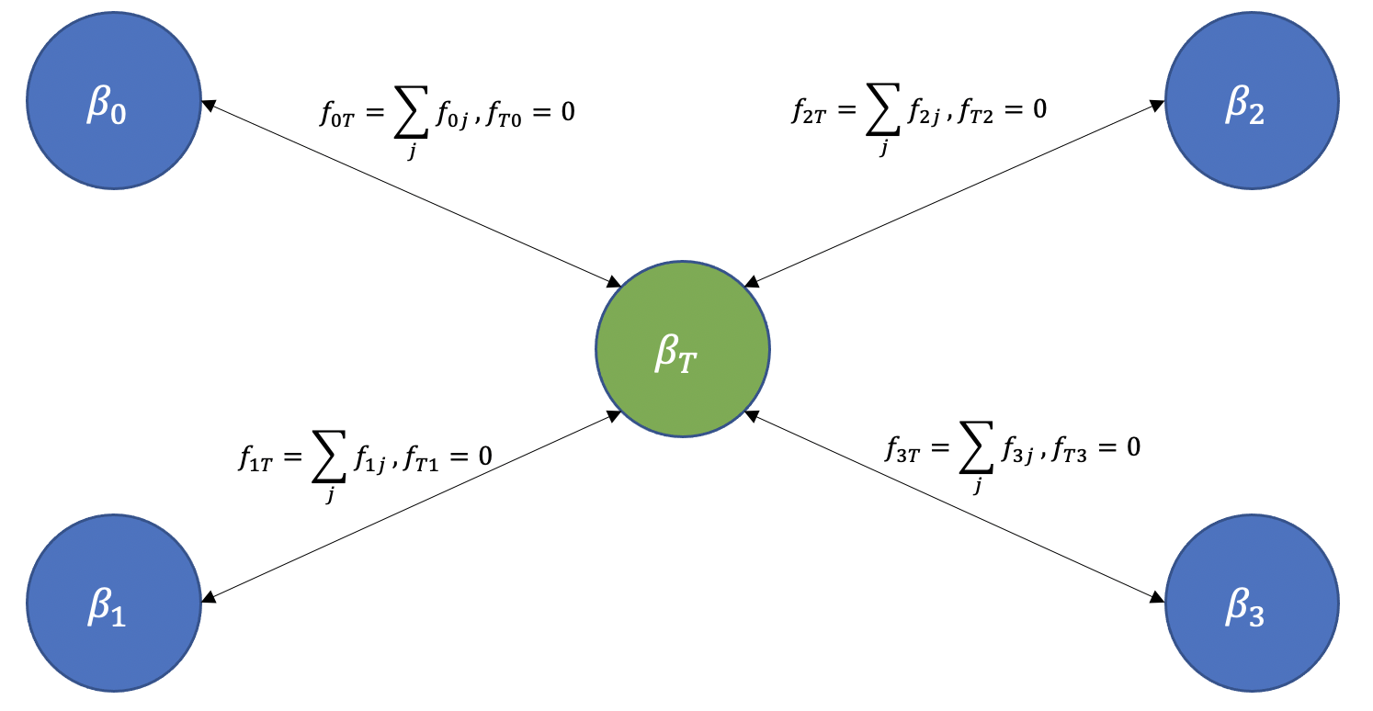
The Mobility Based SIR Model – Inter-region Mixing
Introduce fictitious transport region
Models the higher infection risk posed by using public transportation.

Slide 13
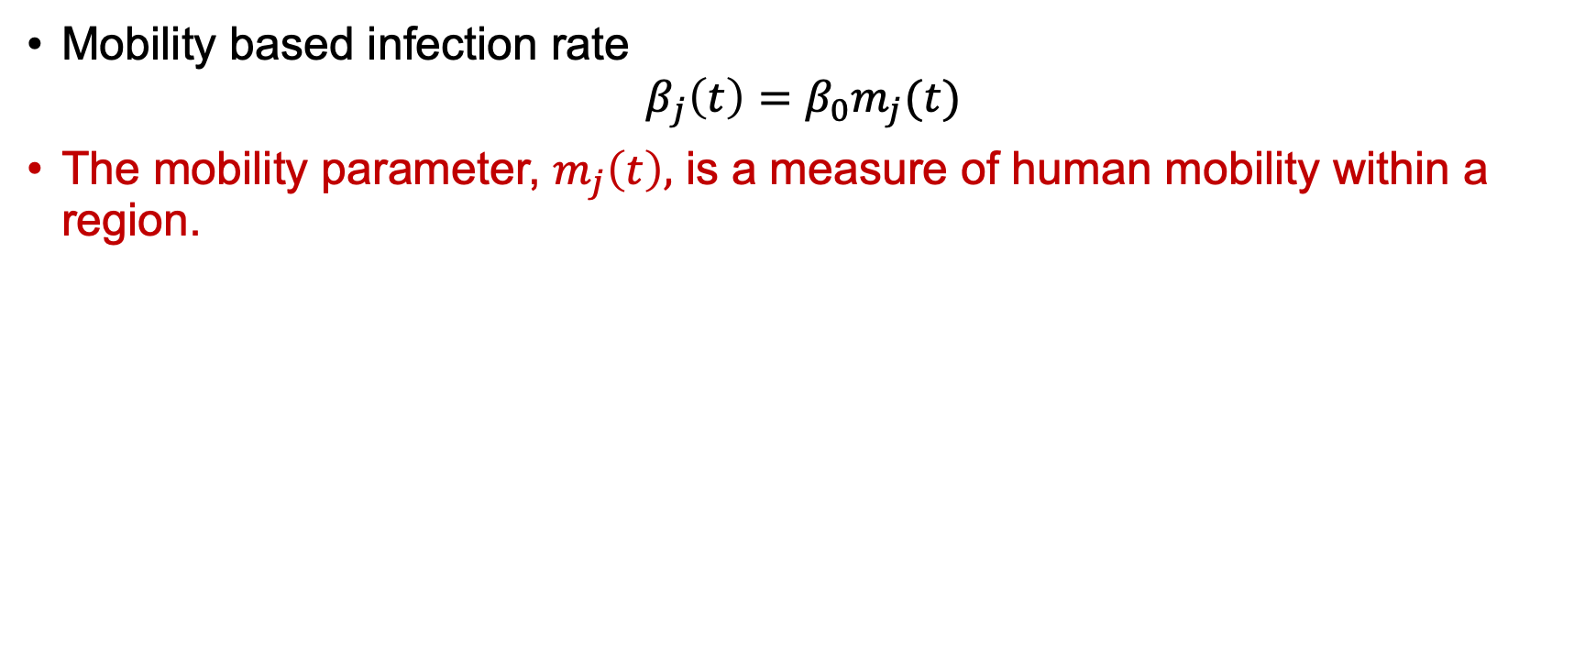
The Mobility Based SIR Model – Intra-region Mixing
Mobility based infection rate
$$β_{j}\left(t\right)=β_{0}m_{j}(t)$$
The mobility parameter, $m_{j}\left(t\right),$ is a measure of human mobility within a region.

Slide 14
Modelling Covid-19 in New York City
Five boroughs of NYC correspond to the regions in our model.
Mixing parameter and mobility parameter constructed from subway usage data.
We use data on the daily reported infections to test our model.

Slide 15
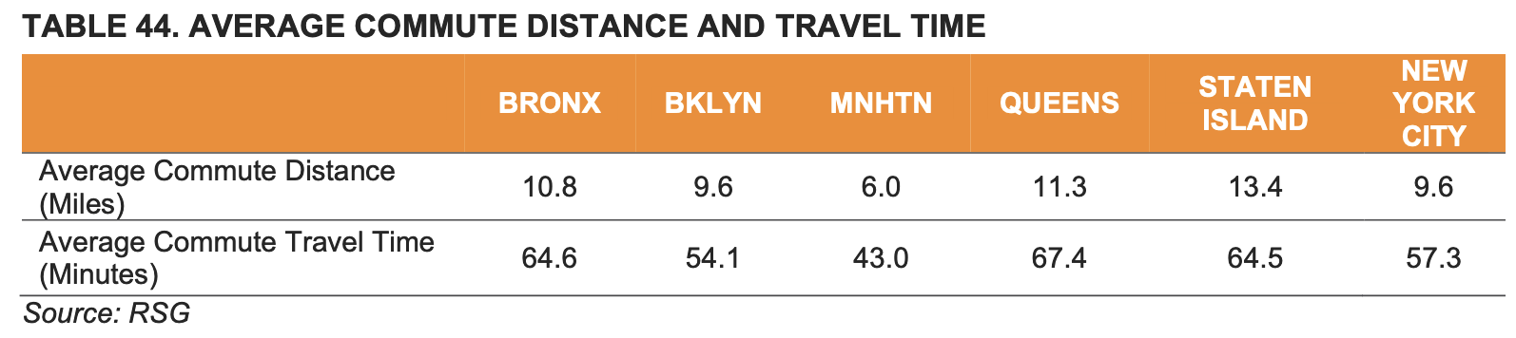
Modelling Covid-19 in New York City – Subway Data
We use a combination of subway turnstile data [1] and survey data [2] to track how many people within a region are using the subway, what their likely destination is and how long they spend away from their home borough
STATION | DATE | TIME | ENTRIES | EXITS
59 ST | 01/01/2020 | 03:00:00 | 0007328037 | 0002483731
59 ST | 01/01/2020 | 07:00:00 | 0007328044 | 0002483742
59 ST | 01/01/2020 | 11:00:00 | 0007328075 | 0002483781

Slide 16
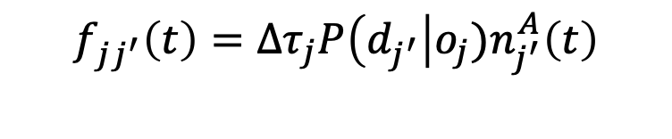
Modelling Covid-19 in New York City – Subway Data
Taken from survey
$$f_{jj^{′}}\left(t\right)=Δτ_{j}P\left(d_{j^{′}}\right|o_{j})n_{j^{′}}^{A}\left(t\right)$$
Inferred from subway turnstile data
Taken from subway turnstile data

Slide 17
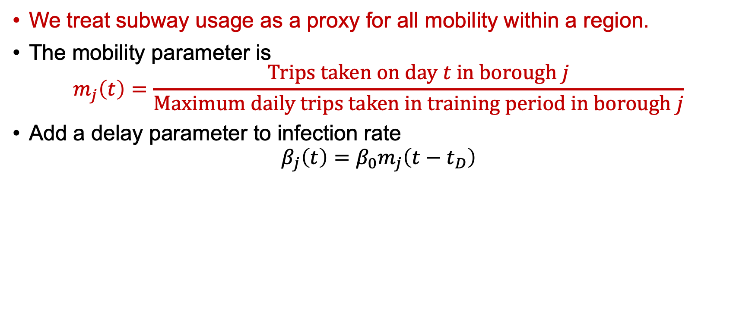
Modelling Covid-19 in New York City – Subway Data
We treat subway usage as a proxy for all mobility within a region.
The mobility parameter is
$$m_{j}\left(t\right)=\frac{Trips taken on day t in borough j}{Maximum daily trips taken in training period in borough j}$$
Add a delay parameter to infection rate
$$β_{j}\left(t\right)=β_{0}m_{j}\left(t−t_{D}\right)$$

Slide 18
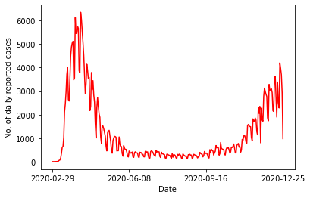
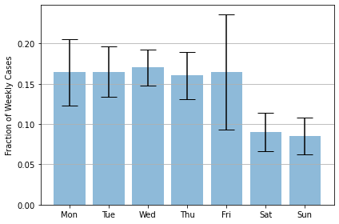
Modelling Covid-19 in New York City – Covid-19 Data
Data on new daily reported cases of Covid-19 taken from the New York State Department of Health [3].

Slide 19
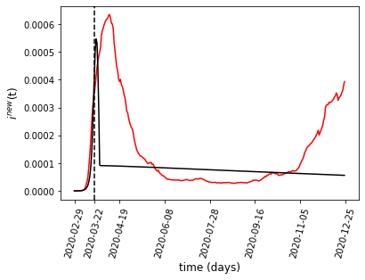
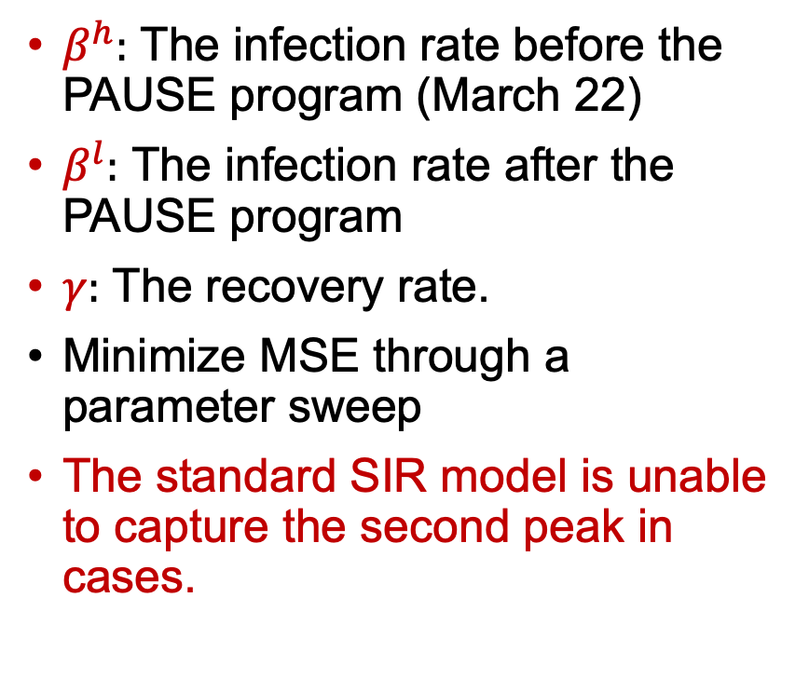
Modelling Covid-19 in New York City – The SIR Model without Mobility
$β^{h}:$ The infection rate before the PAUSE program (March 22)
$β^{l}:$ The infection rate after the PAUSE program
$γ:$ The recovery rate.
Minimize MSE through a parameter sweep
The standard SIR model is unable to capture the second peak in cases.

Slide 20
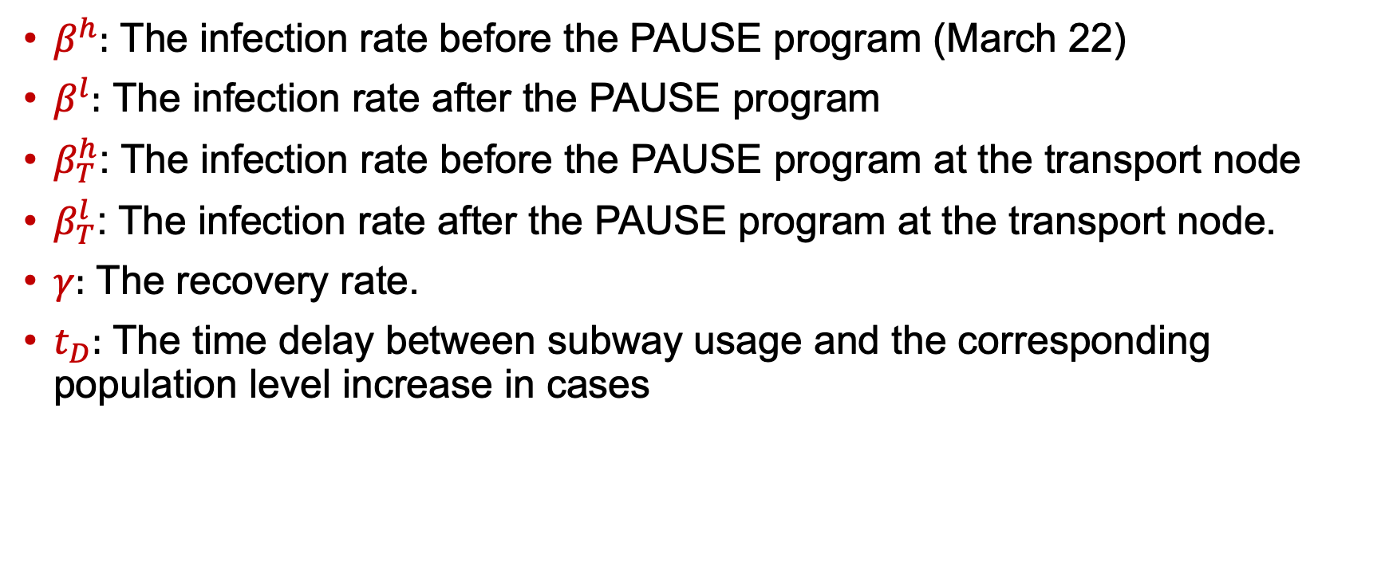
Modelling Covid-19 in New York City – Parameters
$β^{h}:$ The infection rate before the PAUSE program (March 22)
$β^{l}:$ The infection rate after the PAUSE program
$β_{T}^{h}$: The infection rate before the PAUSE program at the transport node
$β_{T}^{l}$: The infection rate after the PAUSE program at the transport node.
$γ:$ The recovery rate.
$t_{D}:$ The time delay between subway usage and the corresponding population level increase in cases

Slide 21
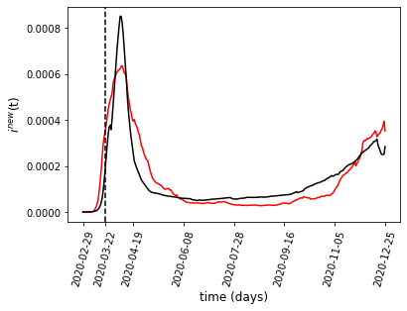
Modelling Covid-19 in New York City – The Mobility Based SIR Model
By incorporating mobility into our model we are effectively able to fit both peaks in the data

Slide 22
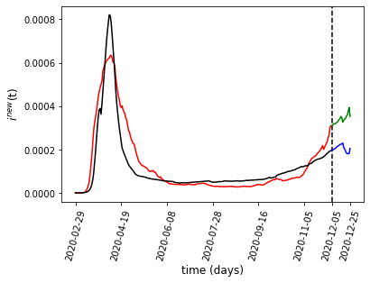
Modelling Covid-19 in New York City – The Mobility Based SIR Model
We also masked the last three weeks of data.
Our model is able to predict the continuing upwards trend of the infections.

Slide 23
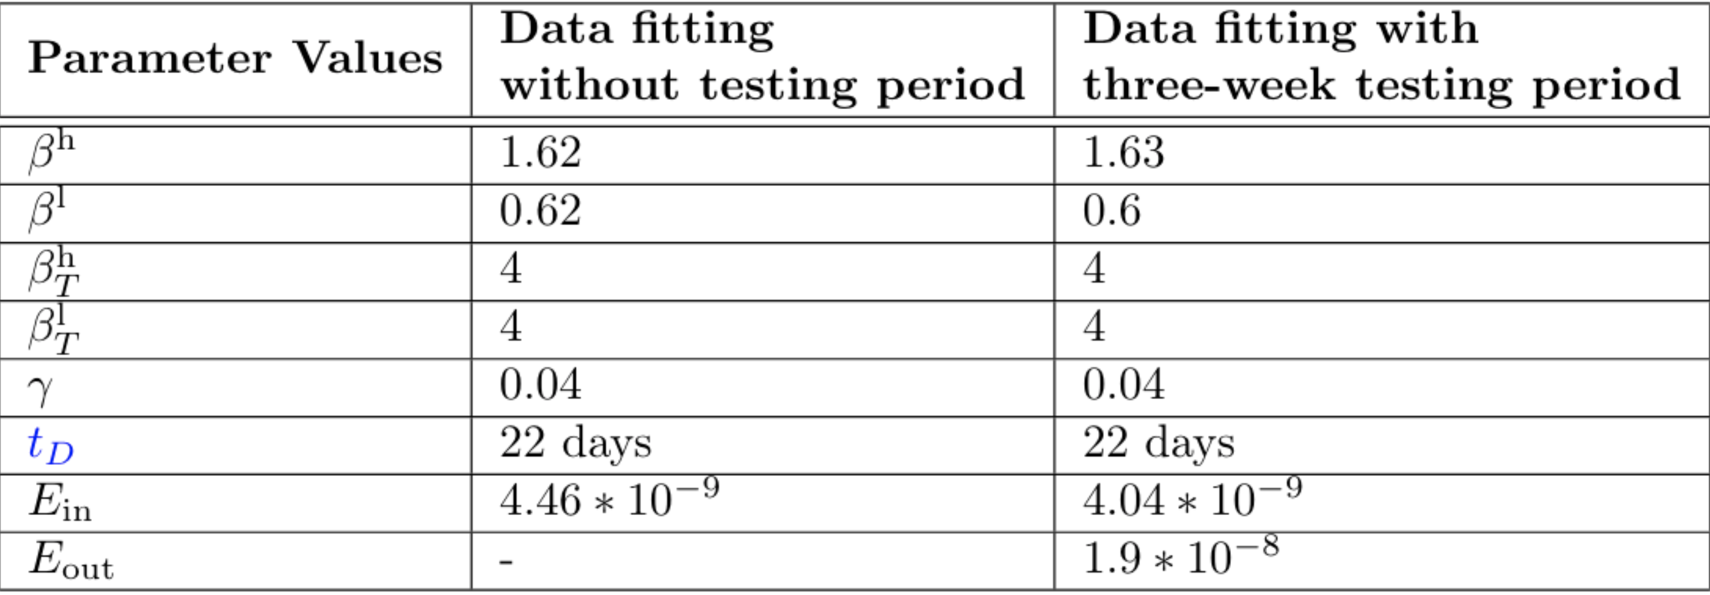
Modelling Covid-19 in New York City – The Mobility Based SIR Model

Slide 24
Conclusion
We propose a model based on SIR dynamics that incorporates mobility in two ways
  Inter-region mobility is modelled as a mixing of the populations of different regions.
  The infection rate of a region is a function of the mobility within that region
Using publicly available data about subway usage, our model is able to effectively capture both peaks in Covid-19 cases in NYC in 2020.
We treat NYC subway usage as a proxy for all mobility within the city.
In future work, we would like to test our model for other cities.
We would also like to incorporate other data into our population compartments, such as access to healthcare.

Slide 25
References
[1] Metropolitan Transportation Authority. Turnstile data.http://web.mta.info/developers/turnstile.html.
[2] RSG. Metropolitan Transportation Authority New York City Travel Survey. Technical report, 06 2020.
[3] New York State Department of Health.Covid-19:Data.https://www1.nyc.gov/site/doh/covid/covid-19-data.page

